Slide 1

PicStudio Lab

Slide 2
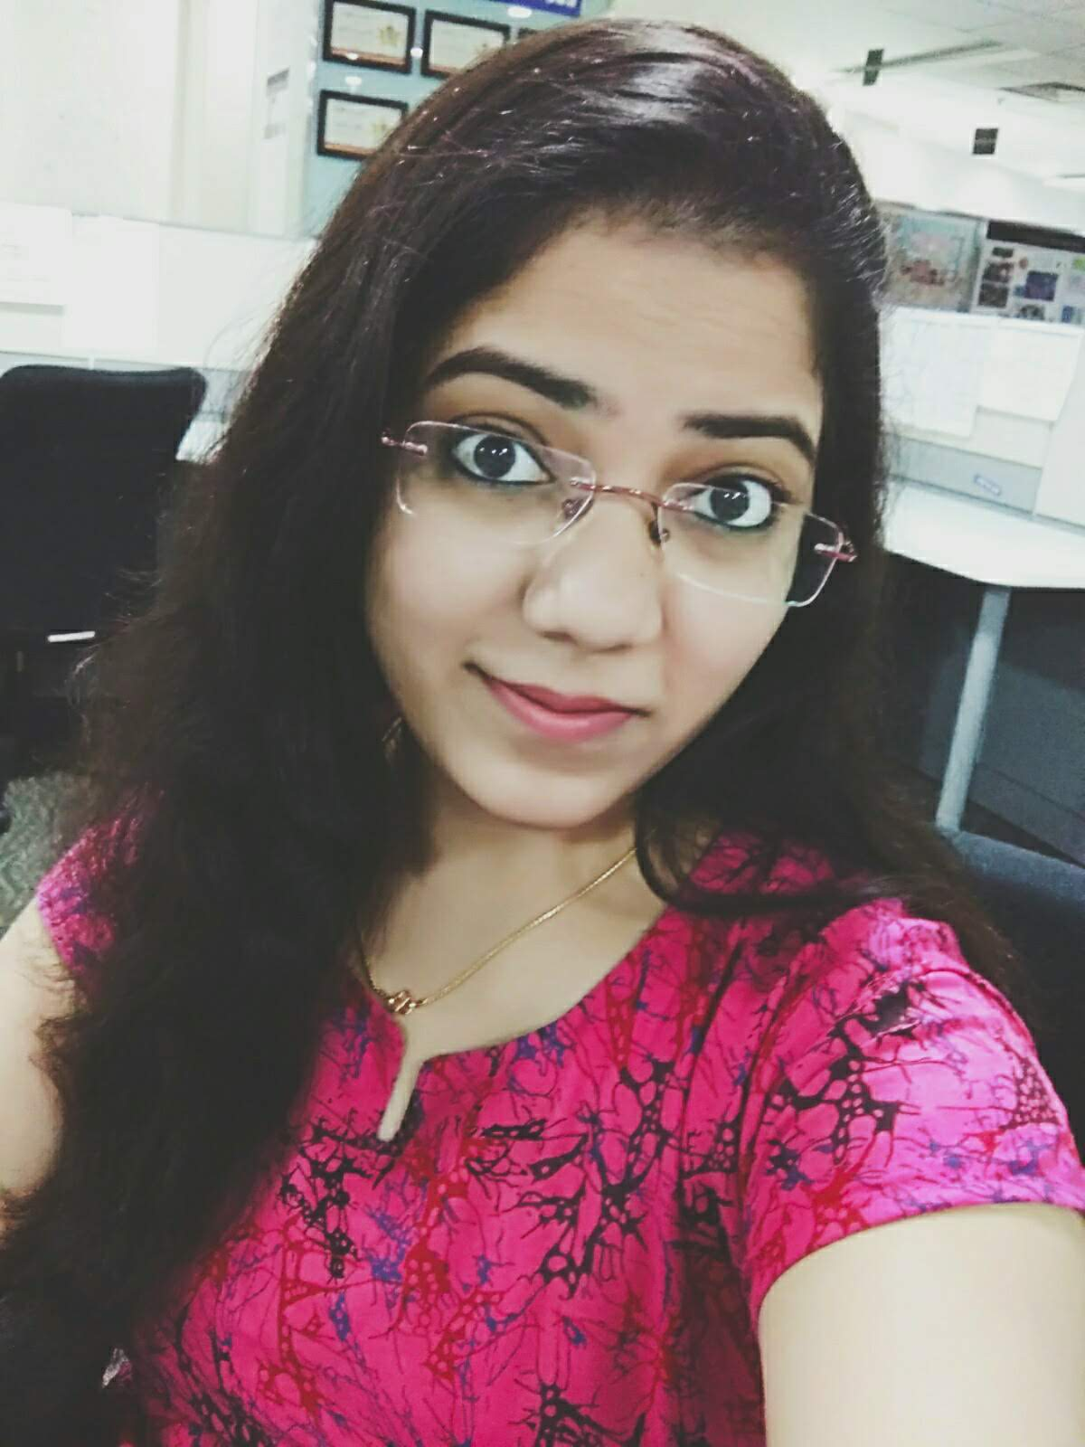
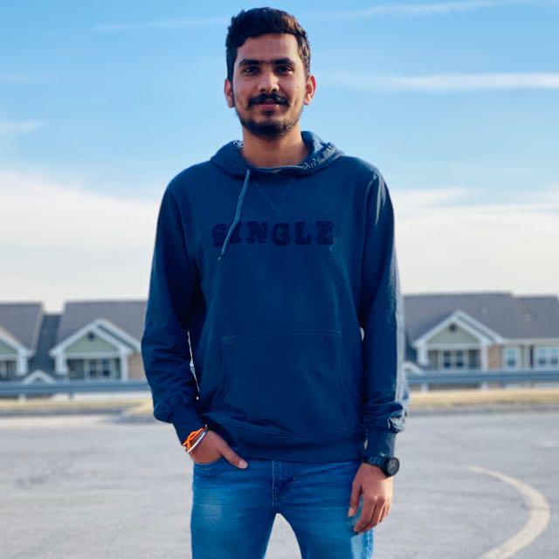
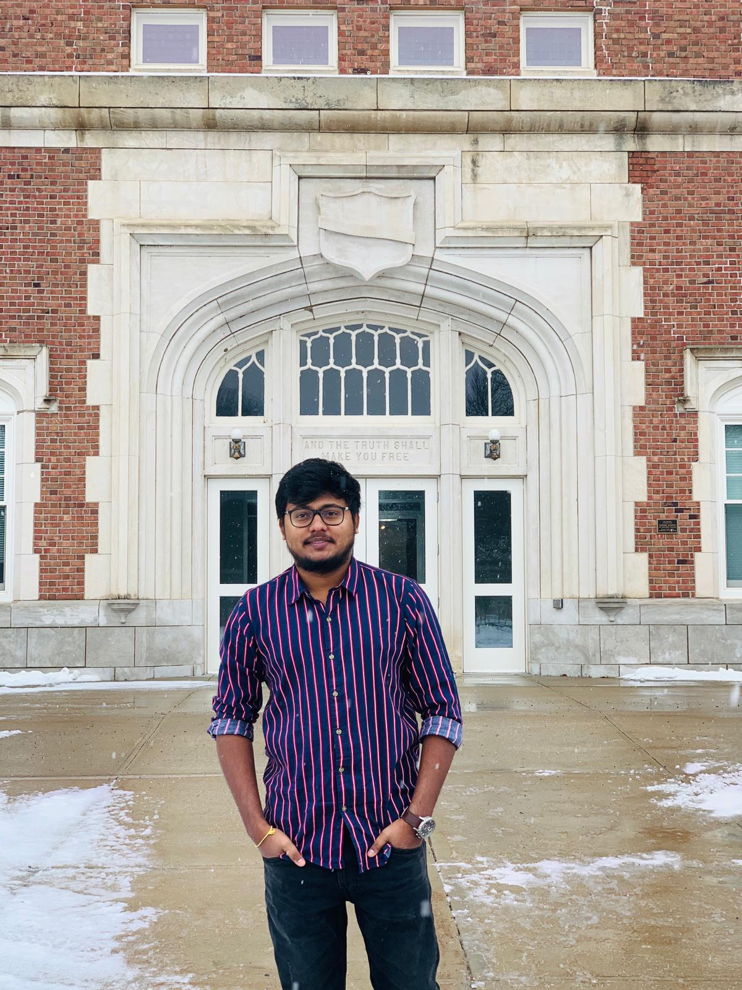
PicStudio Lab
Team Members:
Sowmya Thogiti Vigneshwar Reddy Lenkala Bharath Kumar Gandhasiri

Slide 3
PicStudio Lab
Project problem with solution:
Many stores have different kinds of shopping areas including groceries, cosmetics, clothing, Photographic studios, Floristry, etc. Nowadays people are being so busy, as they don’t have time to step into a photographic studio and grab the frames by selecting them in-person providing the photographs of their loved ones. But our application PicStudio Lab is going to make it easy for people in making their memories with a wide variety of frames available to rest on their home walls by just ordering online.
All the solutions to the above problem has been addressed in the next slides by providing brief description and screenshots. All the activities and features we planned for are in completed status.

Slide 4
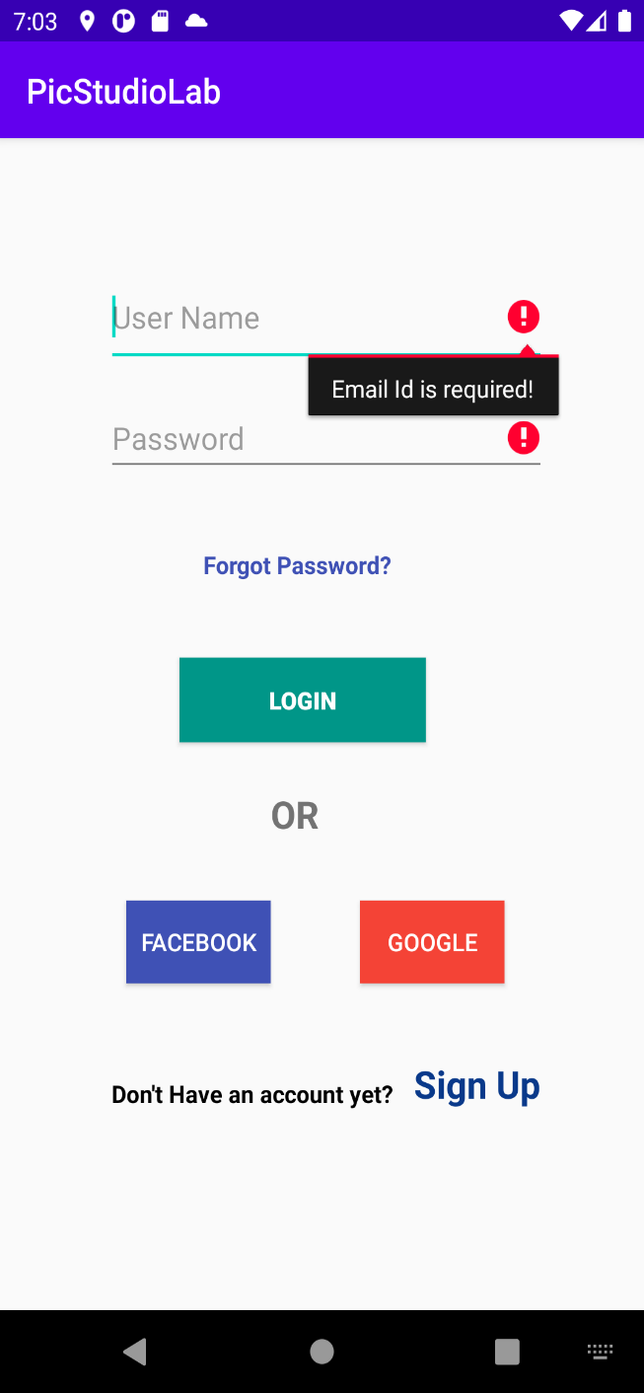
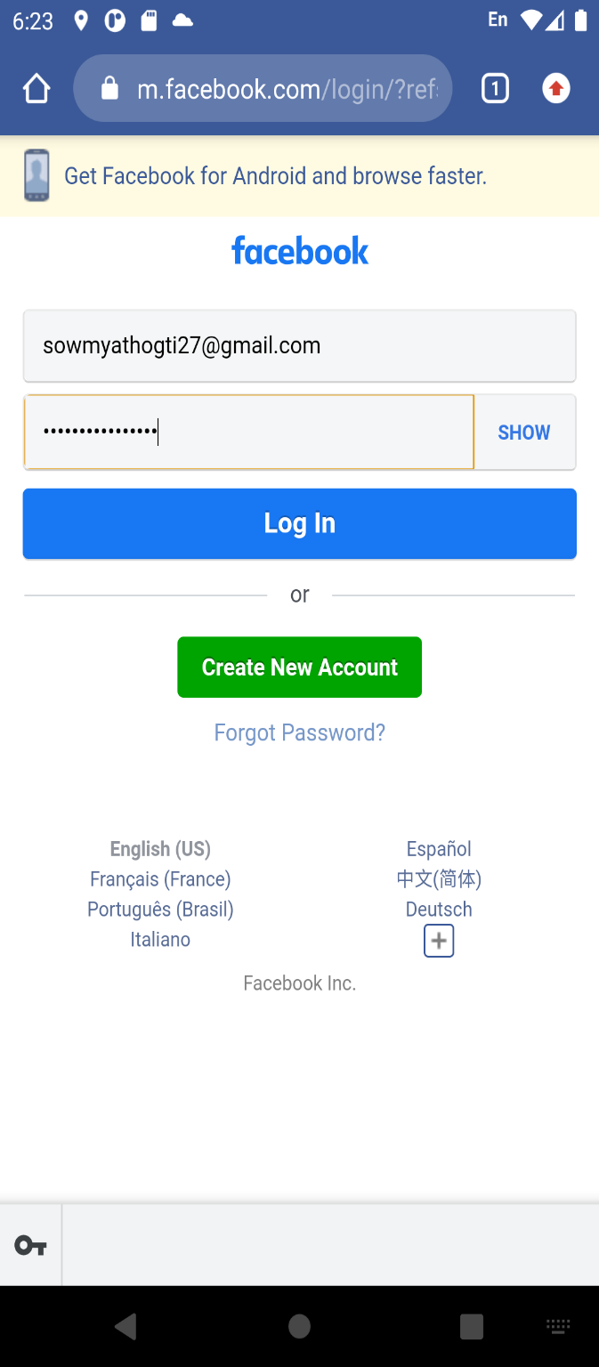
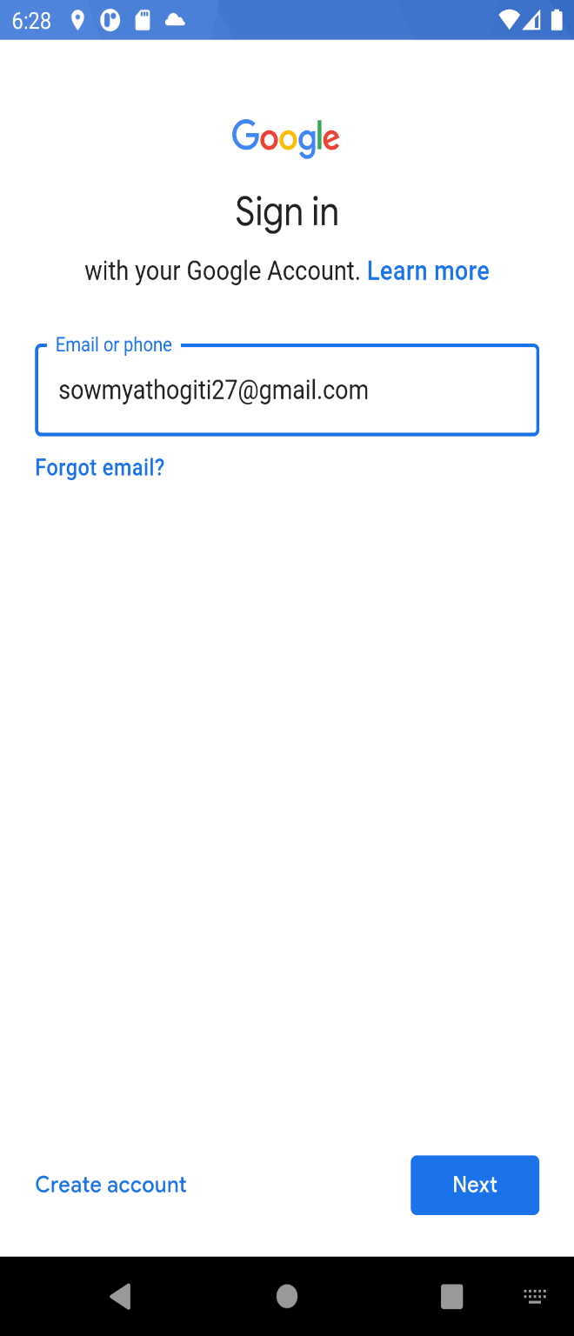
PicStudio Lab
Login Activity (completed):
The purpose of the login activity is to help users to log in to the application using signup credentials, Facebook/Gmail account.

Slide 5
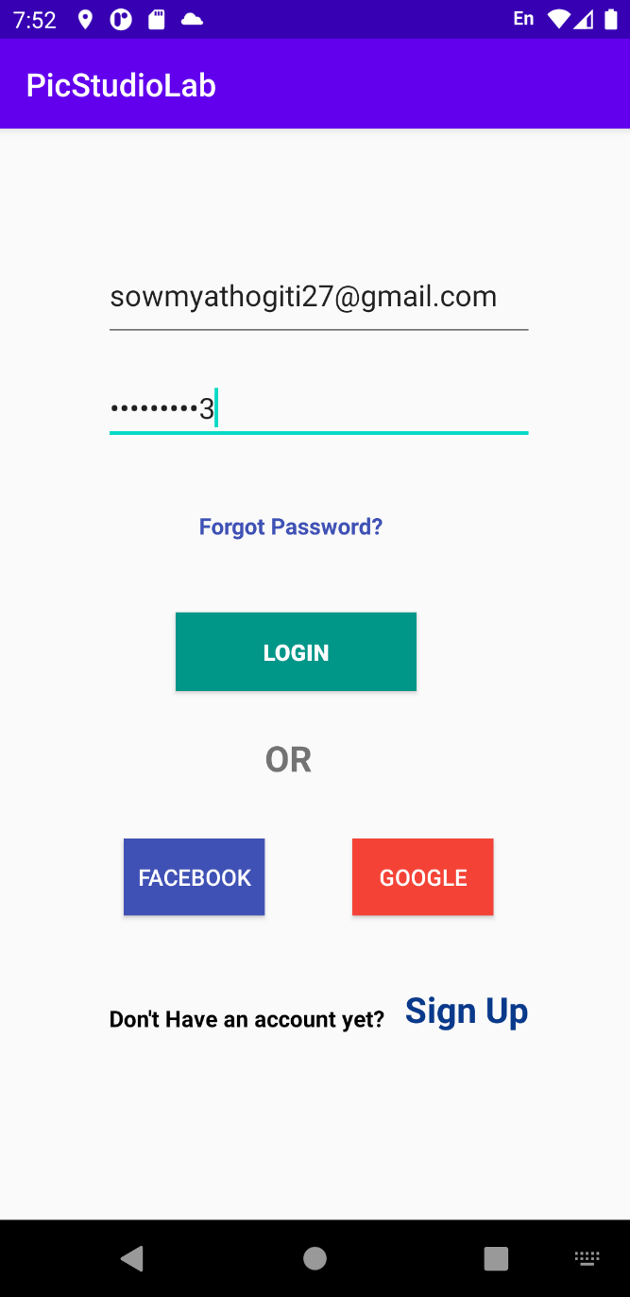
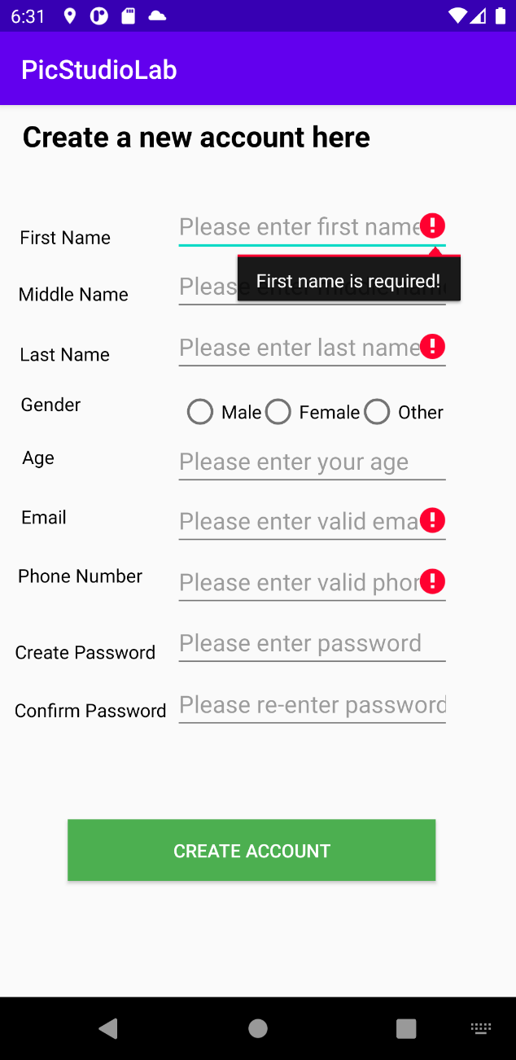
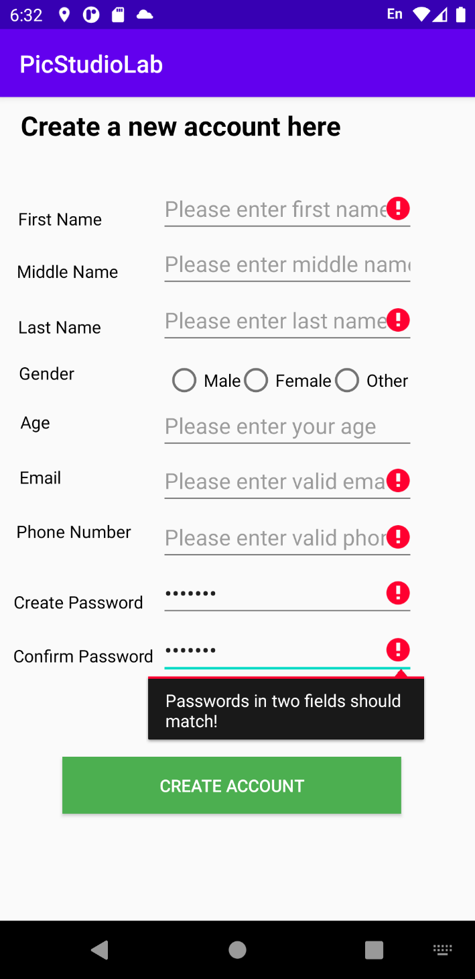
PicStudio Lab
Signup Activity (completed):
The purpose of create profile activity is to help users to first signup and set up all basic details and then activate it through link sent to registered mail id upon account creation.

Slide 6
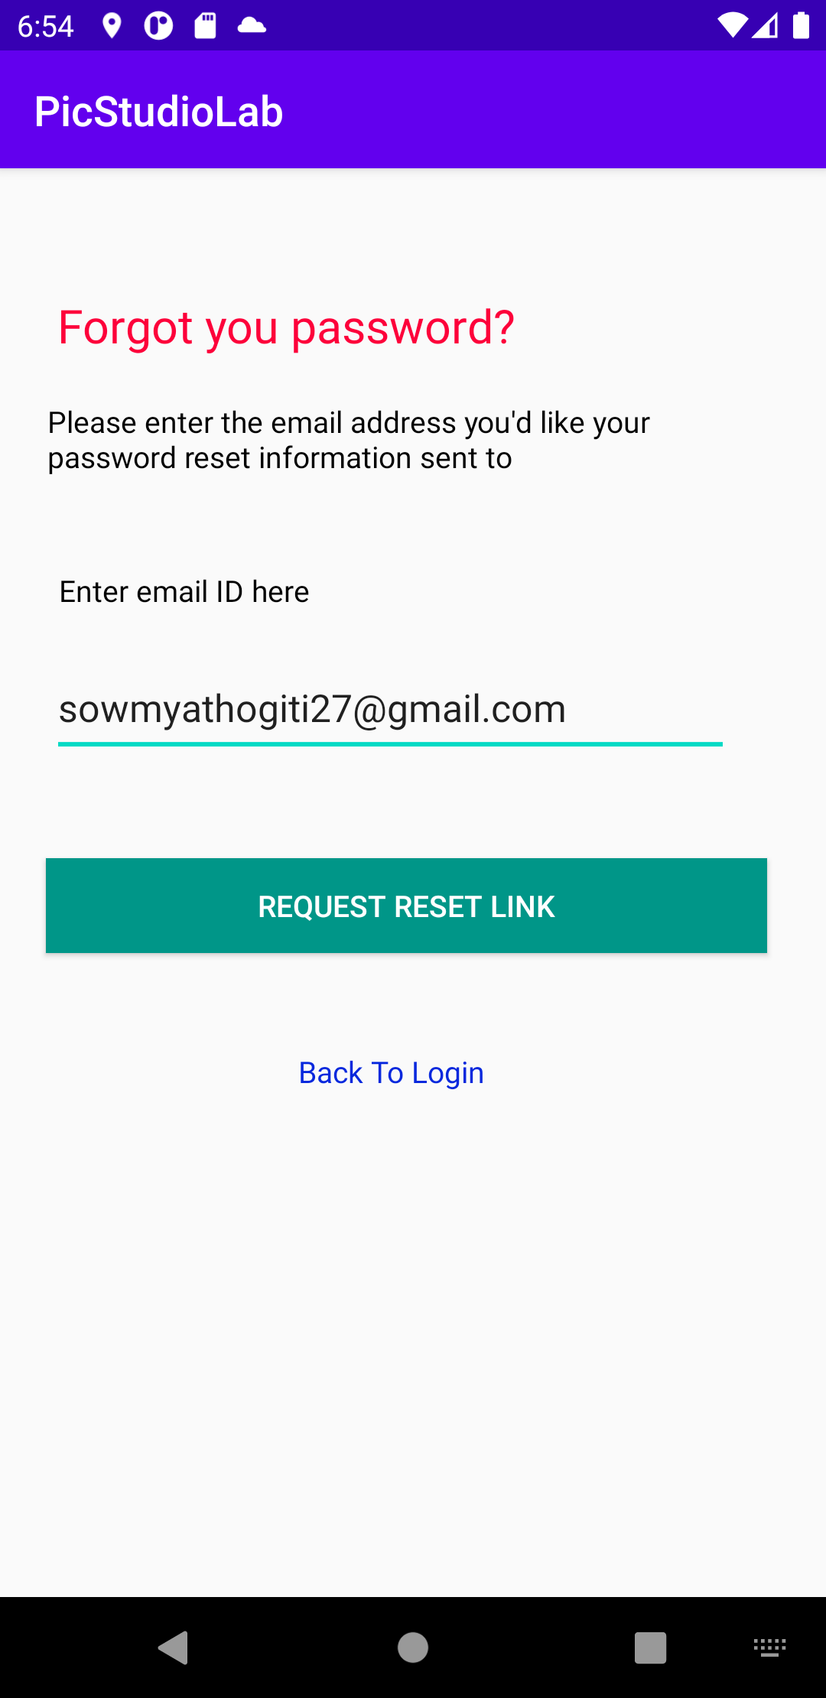
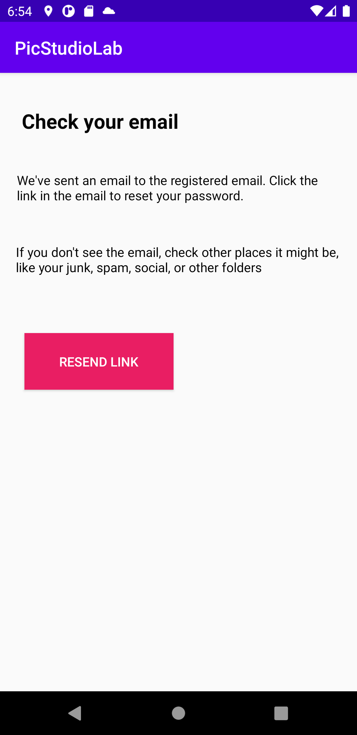
PicStudio Lab
ForgotPassword Activity (completed):
The purpose of forgot password activity is to help users to reset the password by providing mail id.

Slide 7
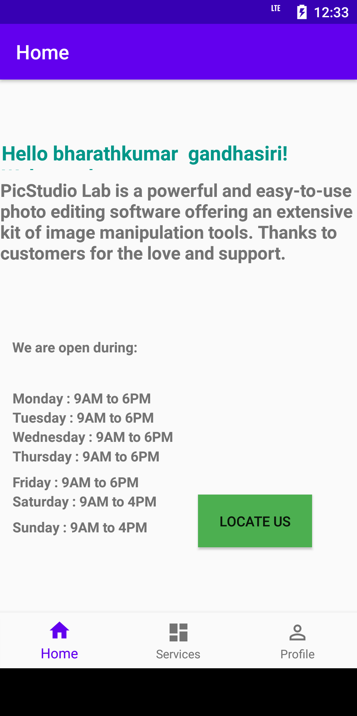
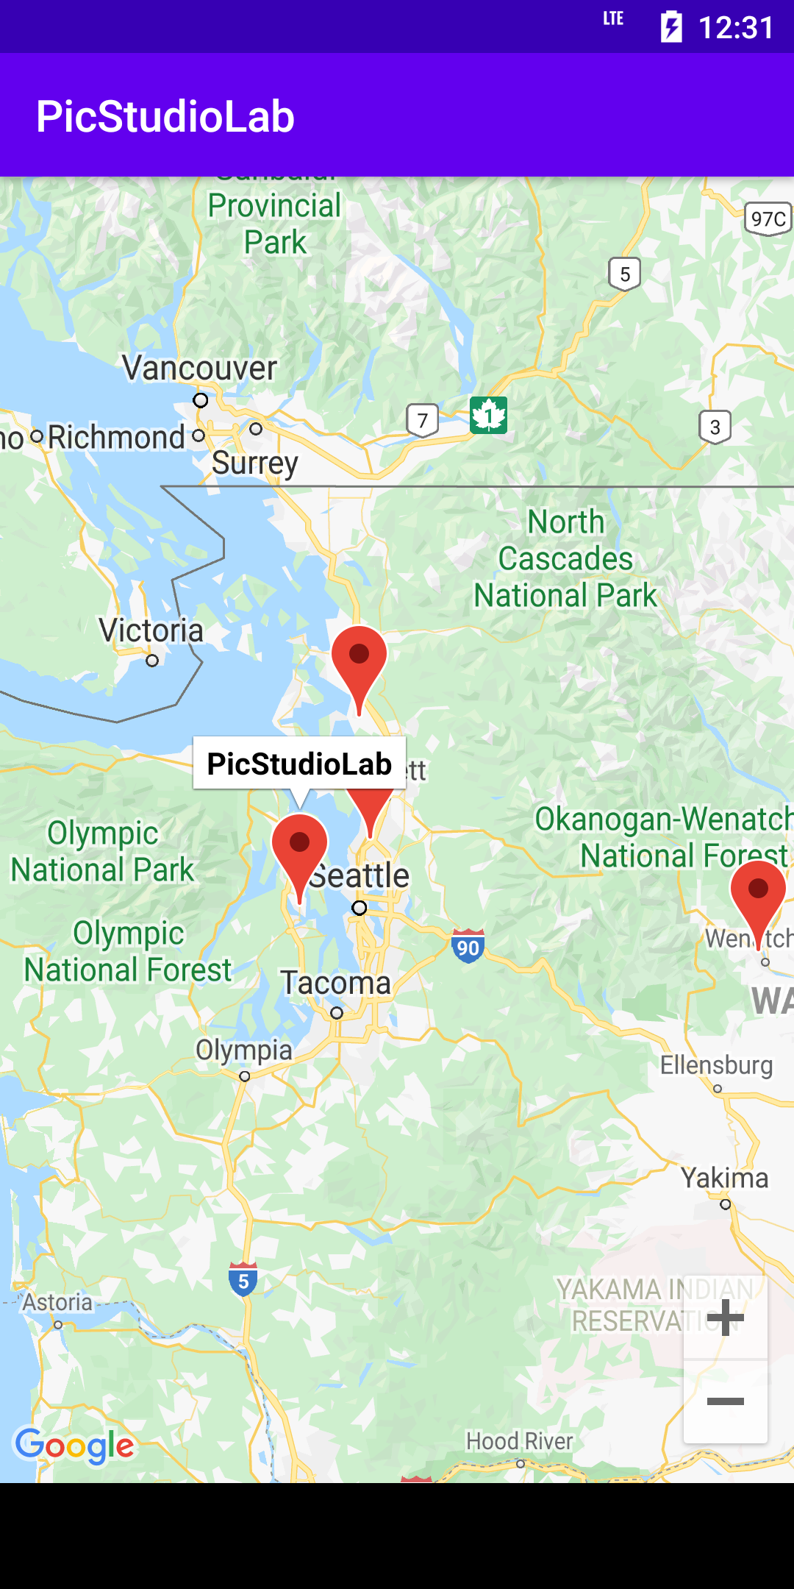
PicStudio Lab
Home Activity <-> Map Activity (completed):
Once the login is done, the home fragment is opened and which enables you to redirect to map activity which shows the location of the offline stores.

Slide 8
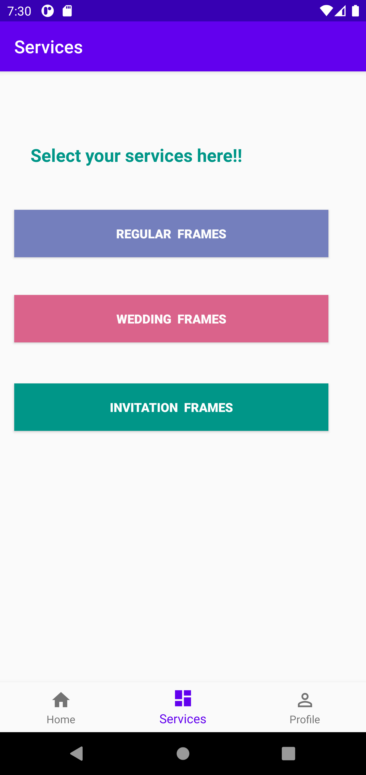
PicStudio Lab
Services fragment (completed):
Once the login is done, we have options to redirect to home, services and profile fragments. In services there are three types of frames to be selected for purchase.

Slide 9
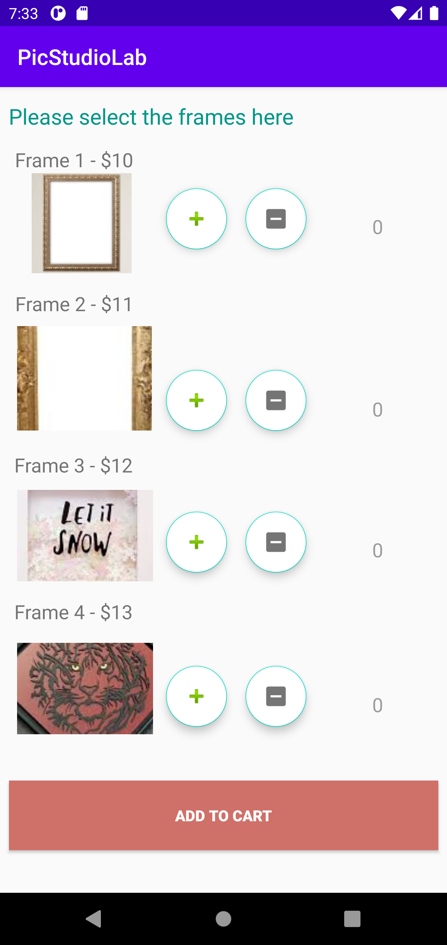
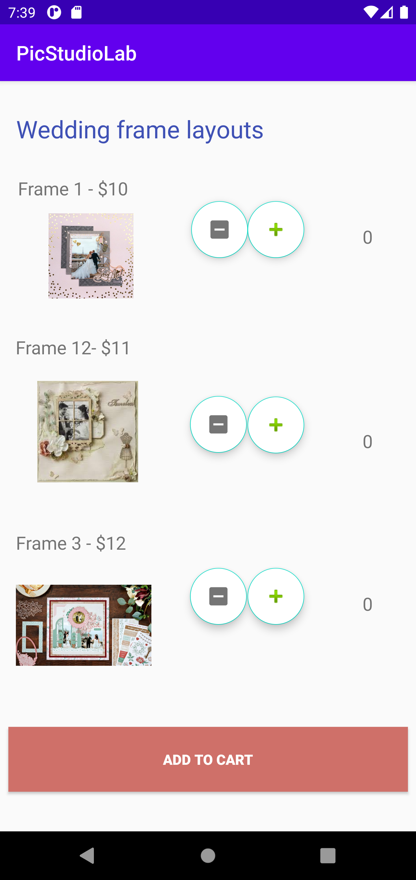
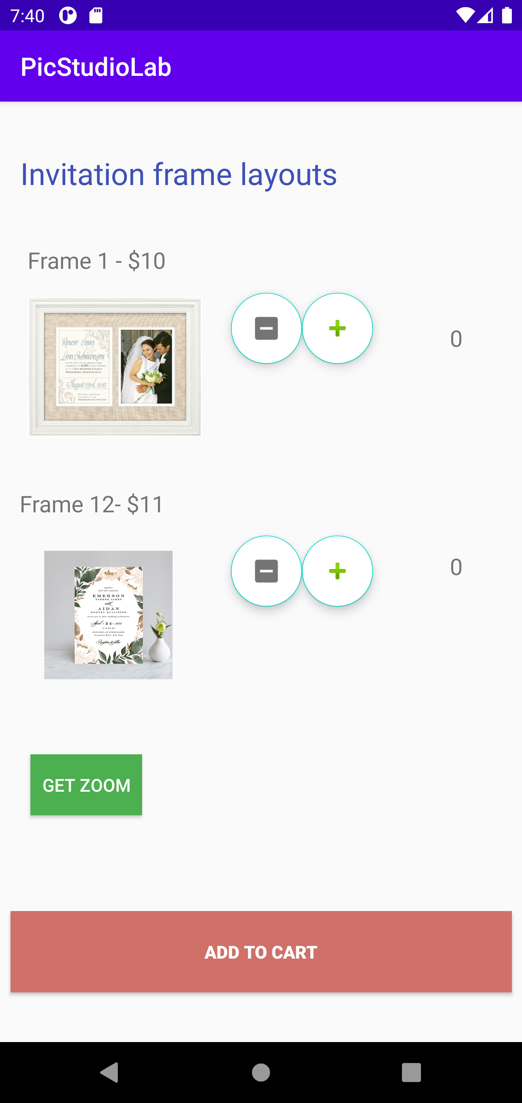
PicStudio Lab
Types of services (completed):
In the services of PicStudio Lab application, we have three different types of services to select frames which are shown below.
Regular frames Wedding frames Invitation frames

Slide 10
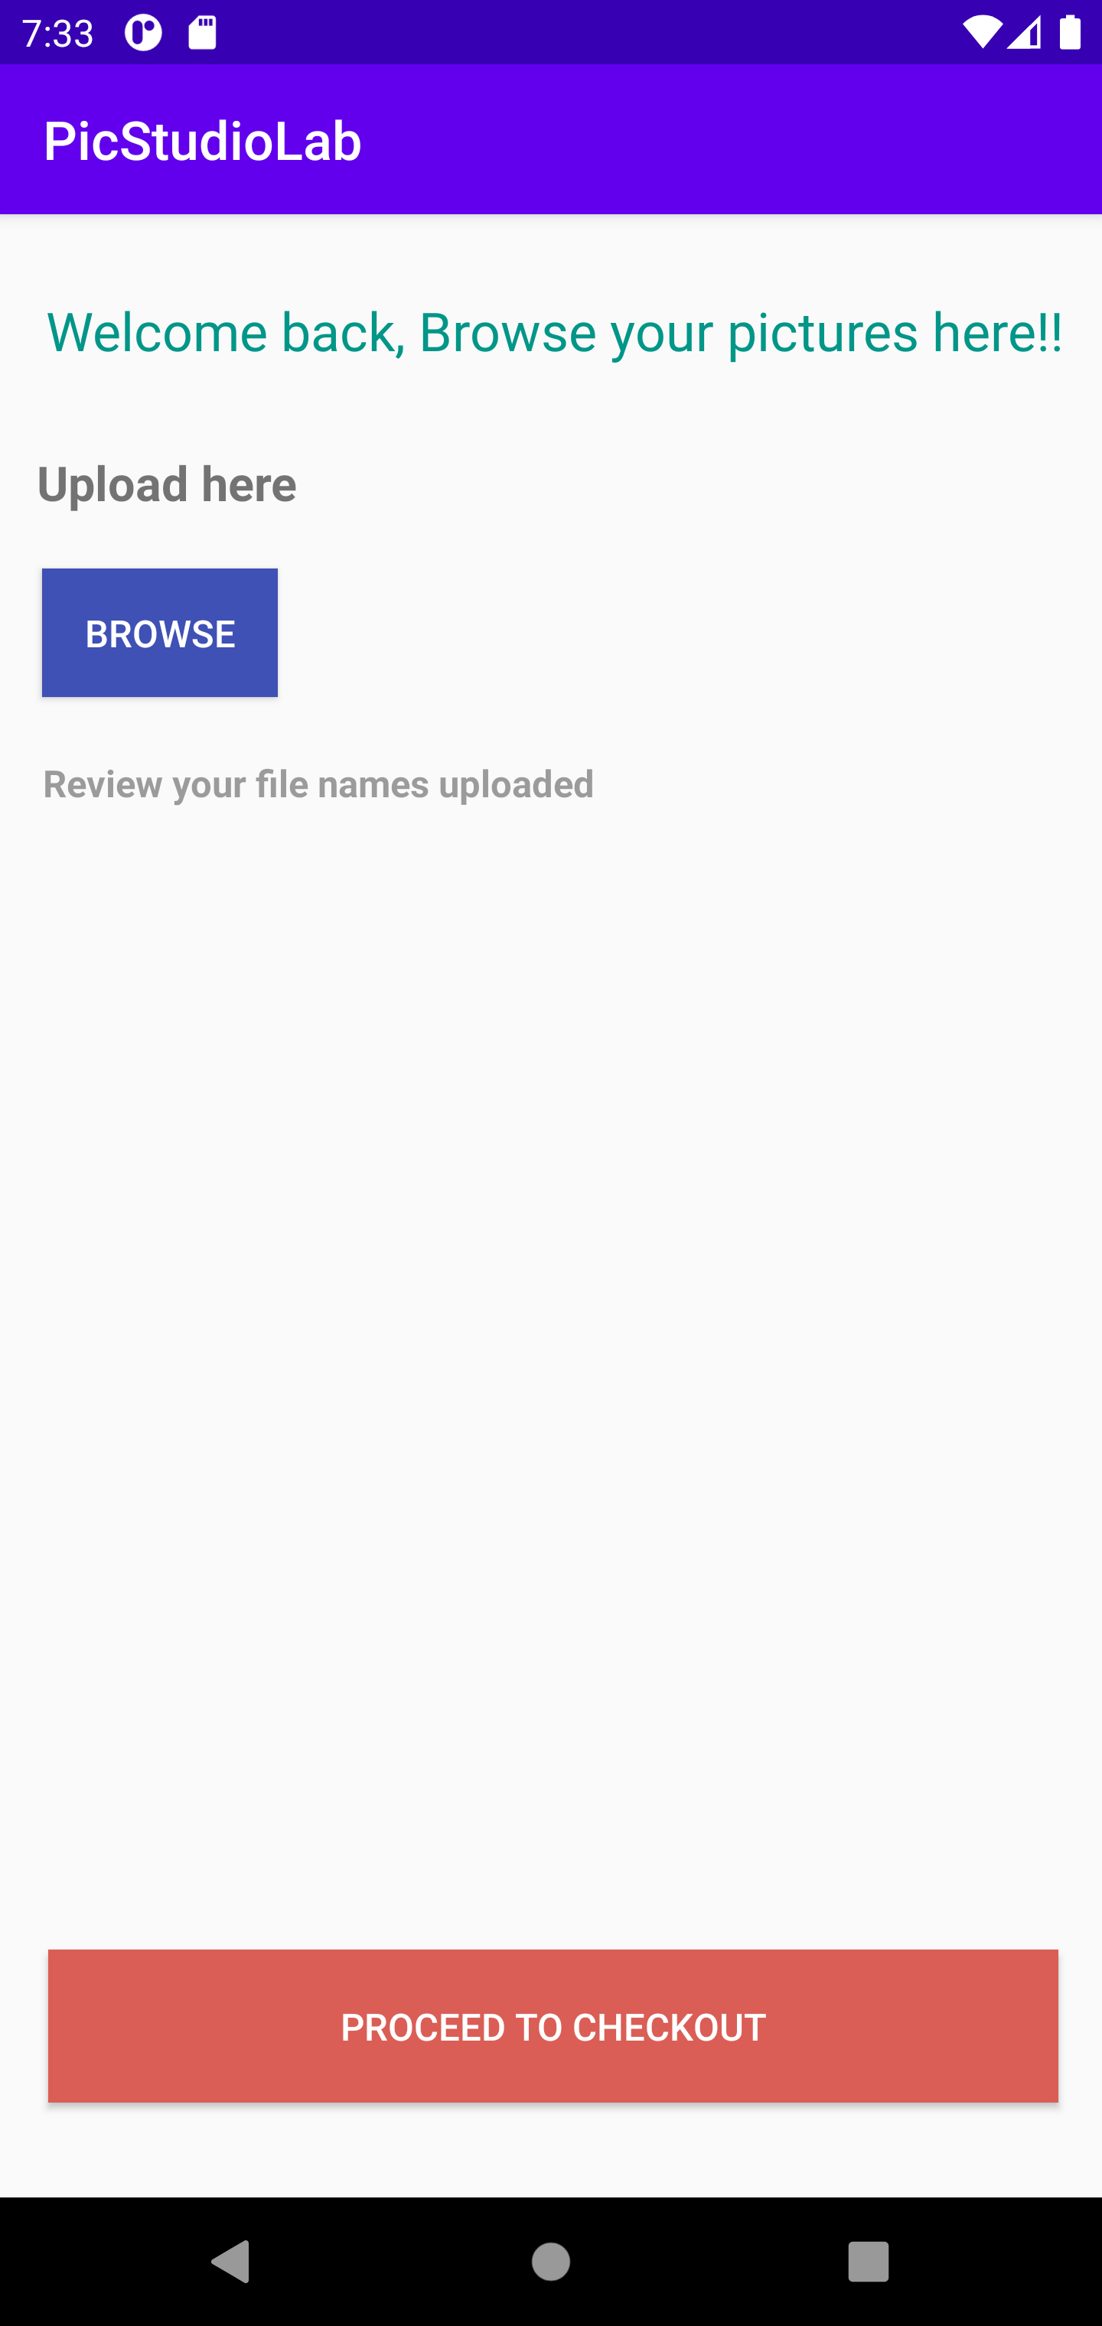
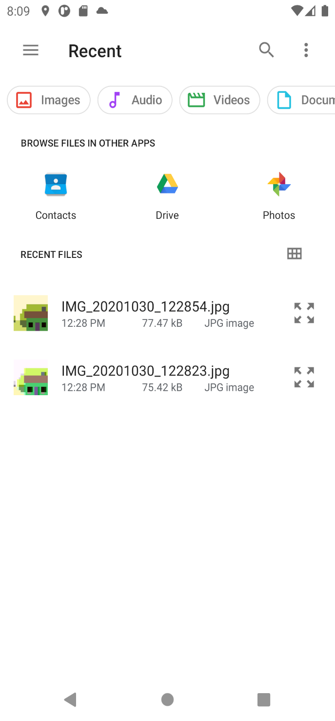
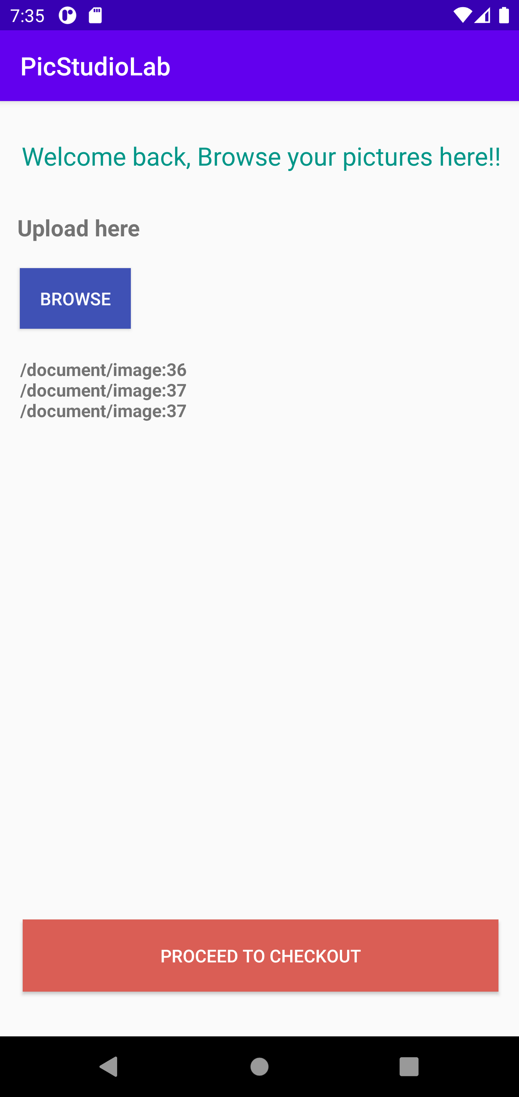
PicStudio Lab
Browse Activity (completed):
For the services provided in PicStudio Lab, we need to select any number of frames and proceed to browse the pictures into the frames by just clicking “add to cart” button.

Slide 11
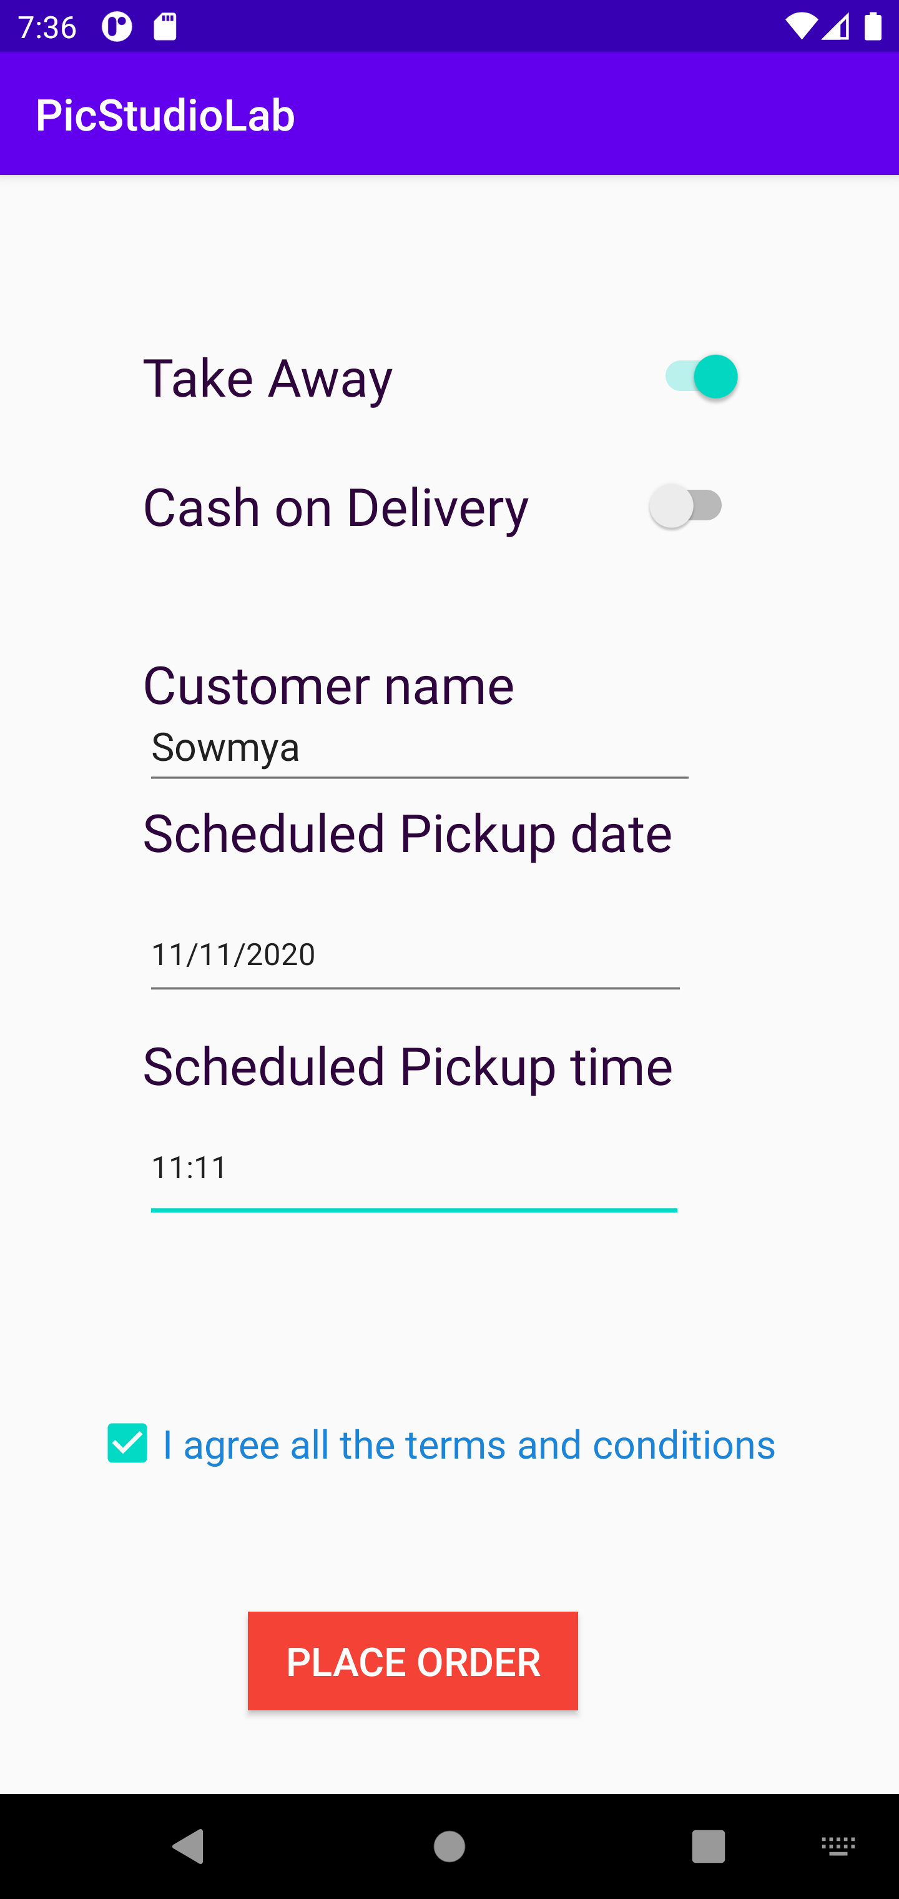
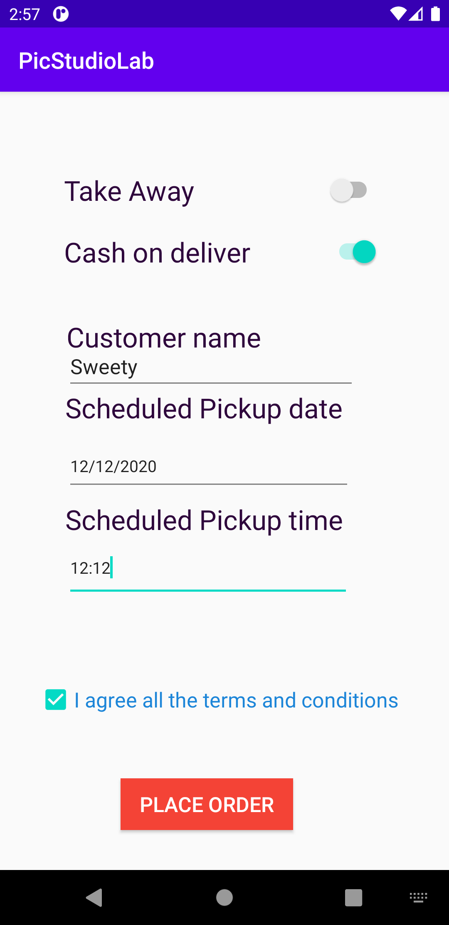
PicStudio Lab
Checkout Activity (completed):
For the services added into cart using PicStudio Lab application, we need to select the options(Take away/cash on delivery) to buy the products by providing few details shown below:

Slide 12
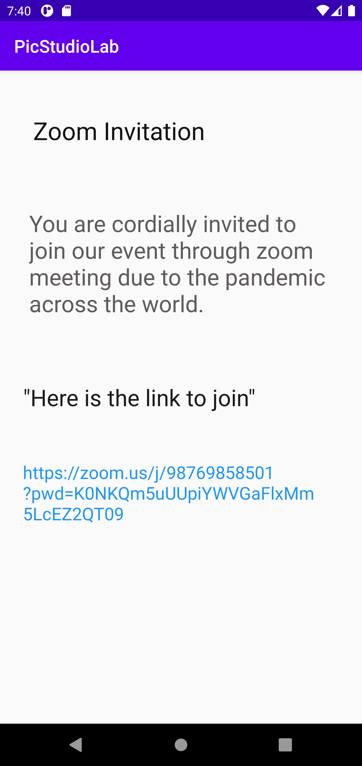
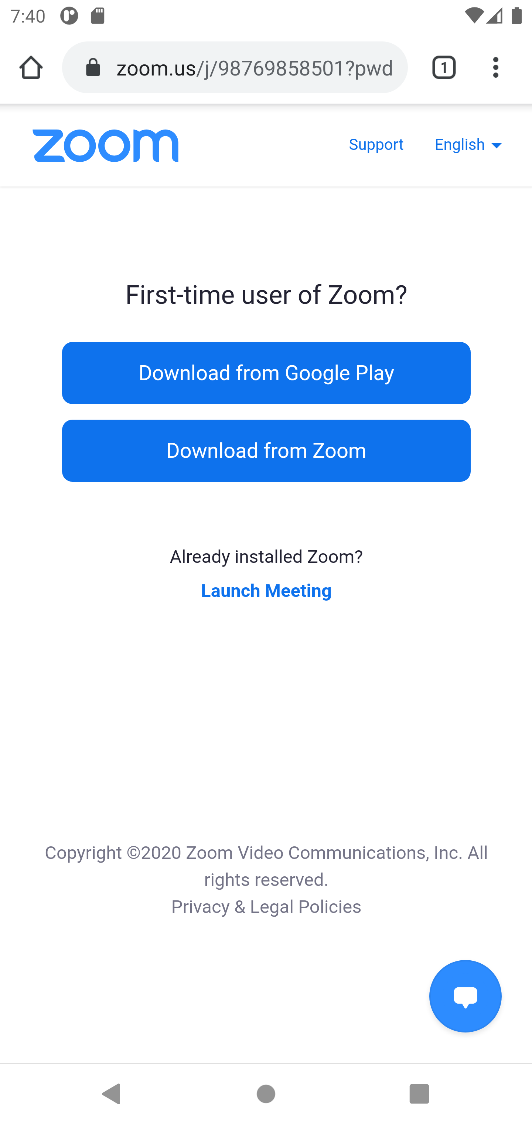
PicStudio Lab
Zoom Invitation Activity (completed):
For the Invitation services added into cart using PicStudio Lab application, we can also get the zoom invitation link to join the event online due to pandemic situation.

Slide 13
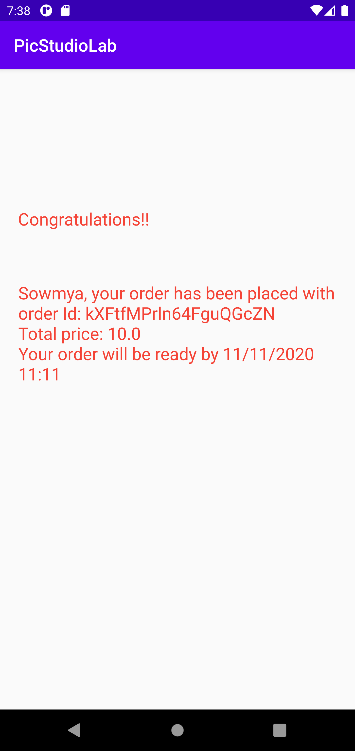
PicStudio Lab
Order confirmation Activity (completed):
For the services added into cart using PicStudio Lab application, we can redirect to order confirmation page after the checkout activity is done and get the unique order id for reference.

Slide 14
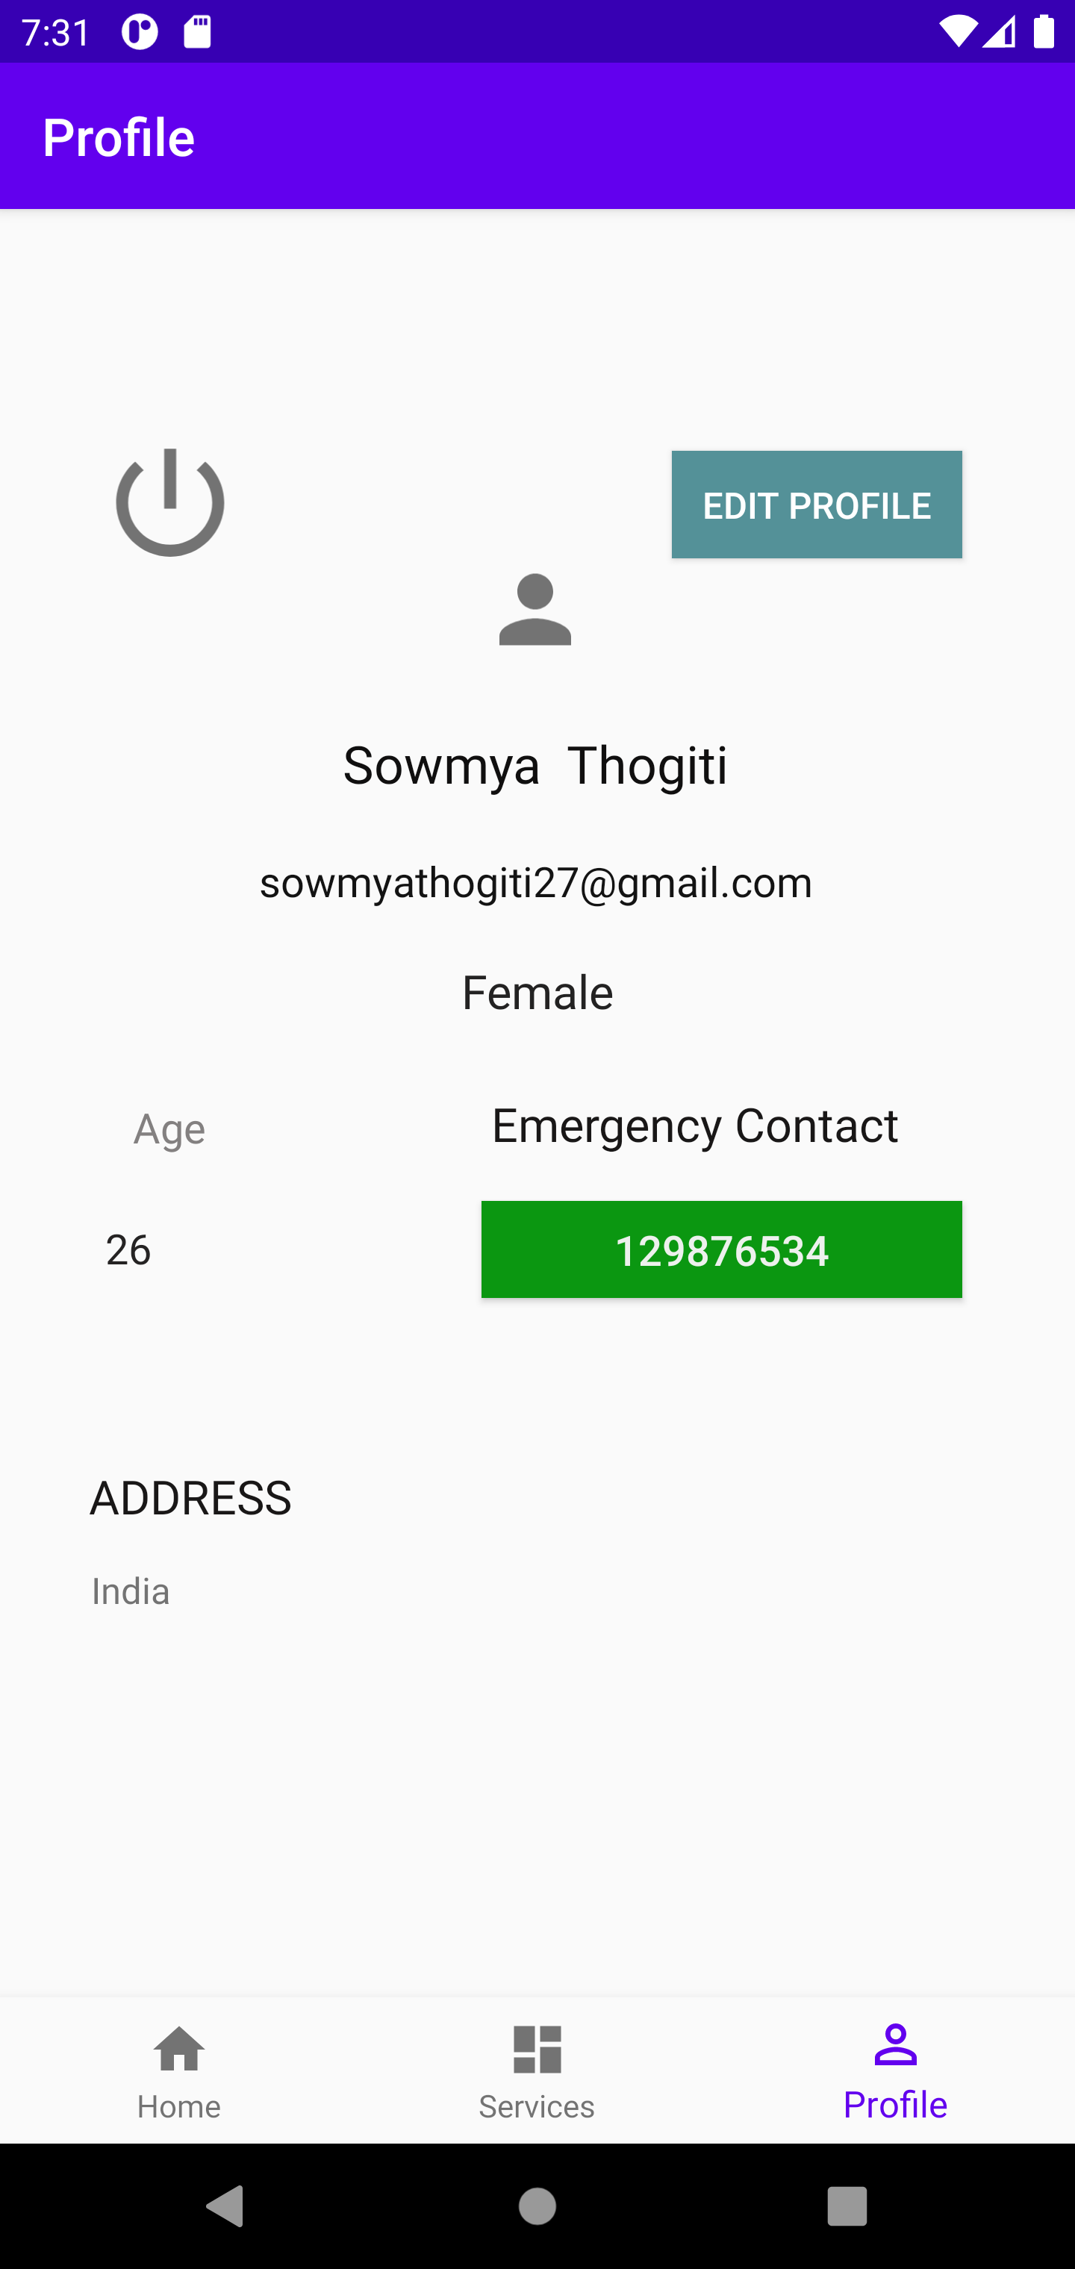
PicStudio Lab
Profile fragment in home activity (completed):
Once the login is done using the credentials provided during registration, we can see three fragments named home, services and profile. Here profile fragment shows the details of the user.

Slide 15
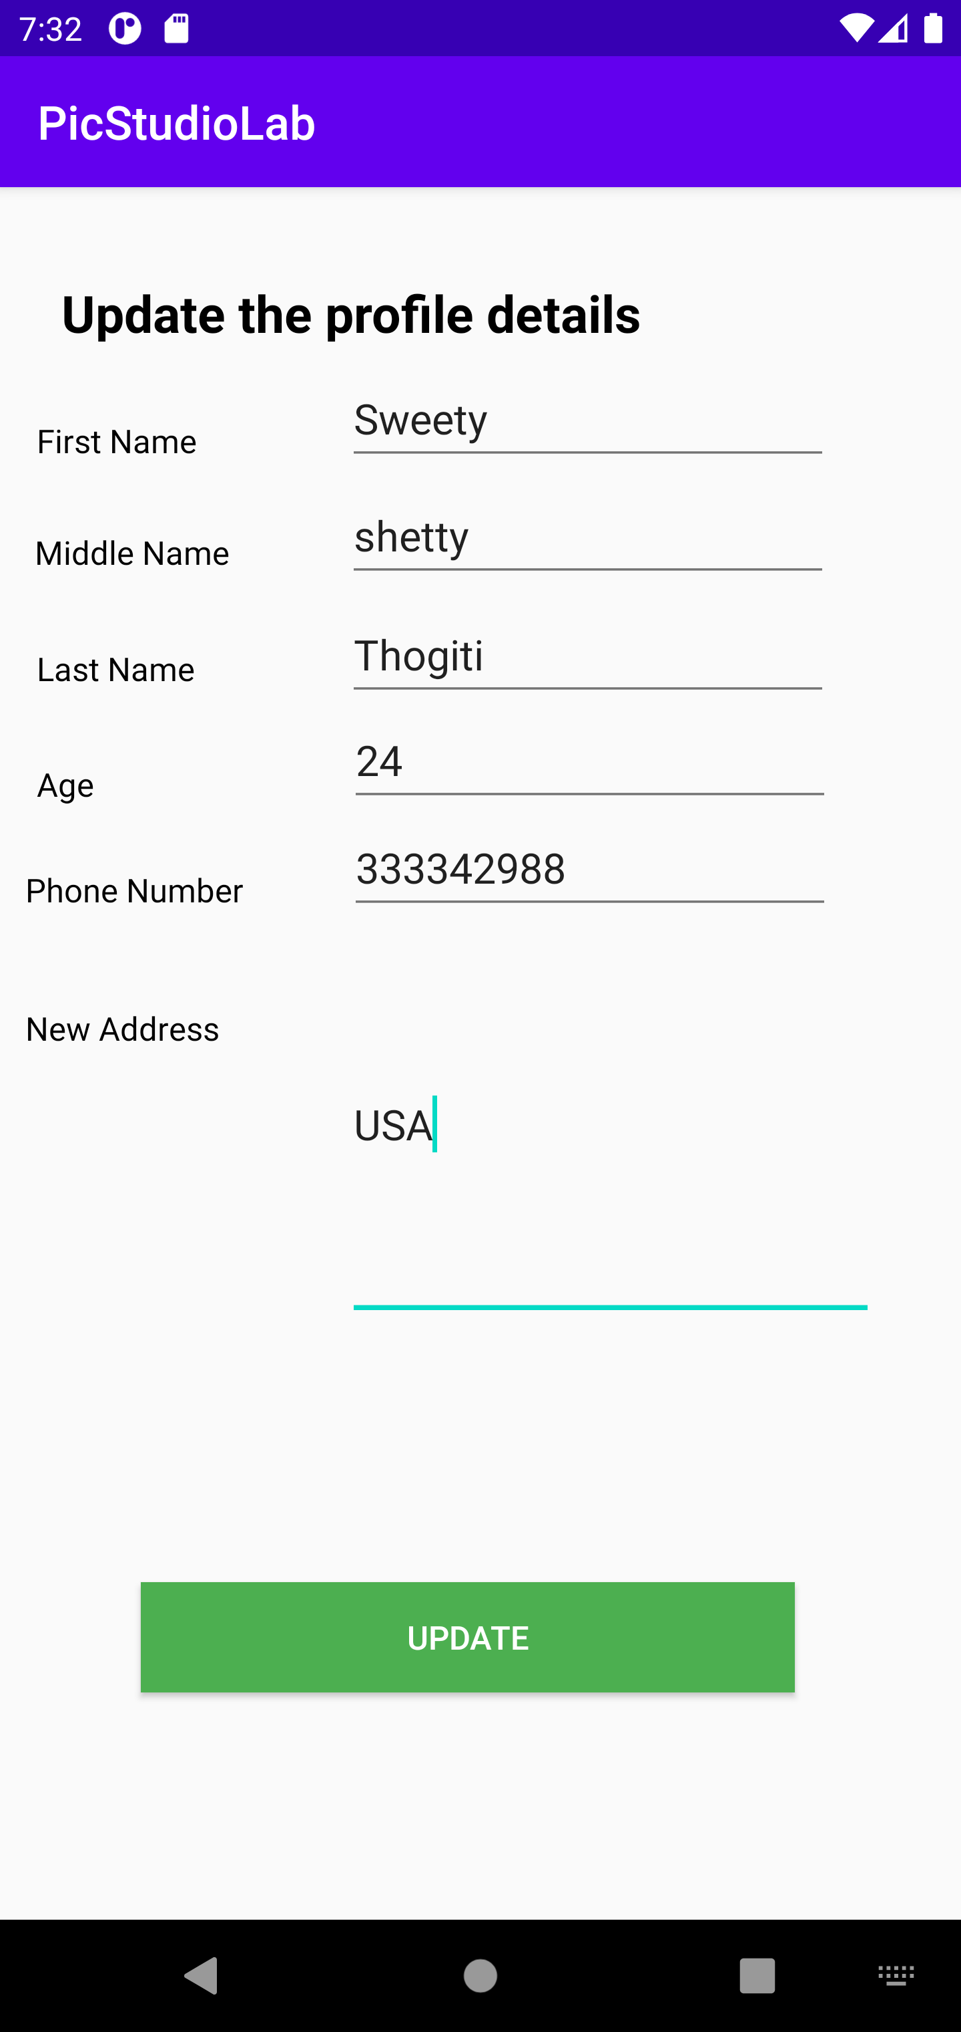

PicStudio Lab
UpdateProfile activity (completed):
UpdateProfile activity will be redirected upon clicking the edit profile in profile fragment. We can update few fields for the user profile provided in update profile page and update the same details in the firebase database.

Slide 16
PicStudio Lab
Logout activity (completed):
Once the login is done using the credentials provided during registration, we can see three fragments named home, services and profile. Here in the profile fragment, we can logout from the application and redirect to login page back using the button with symbol

Slide 17

PicStudio Lab
Any Questions??

